Slide 1
Human Trafficking Modern Day Slavery June 10, 2016 Presented by: Meghan Murray
Rick Scott Governor
Barbara Palmer
Director

Slide 2
Who is APD?
APD provides Home and Community Based Waiver Services (HCBS) to individuals with Developmental Disabilities
Autism
Cerebral Palsy
Down syndrome
Intellectual Disabilities
Prader-Willi syndrome
Spina bifida
Phelan Mcdermid syndrome

Slide 3
Human Trafficking
Federal Law: The Trafficking Victims Protection Act of 2000
Severe forms of human trafficking –
a) Sex trafficking in which a commercial sex act is induced by force, fraud, or coercion, or in which the person induced to perform such an act has not attained 18 years of age; or
b) The recruitment, harboring, transportation, provision, or obtaining of a person for labor or services, through the use of force, fraud or coercion for the purpose of subjection to involuntary servitude, peonage, debt bondage, or slavery
Florida Statute Chapter 787.06(2)(d)
Transporting, soliciting, recruiting, harboring, providing, enticing, maintaining, or obtaining another person for the purpose of exploitation of that person

Slide 4
Human Trafficking
Is this horrific crime actually a problem?
Yes
$32 - $34 Billion Industry
Approximately 27 Million People Enslaved Worldwide

Slide 5
Florida is Ranked number 3 in the Nation
Human Trafficking

Slide 6
Too Close to Home - Documentary on South Florida HT

Slide 7
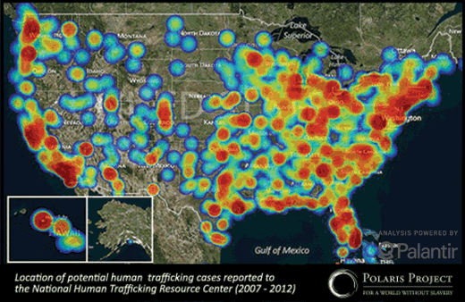
Notes:
According to the U.S. Department of Justice states south Florida is the third busiest sex trafficking region in the country.
Florida Hubs – Tallahassee, Jacksonville, Orlando, Miami, Ft. Myers, Tampa. (aka circuit)

Slide 8
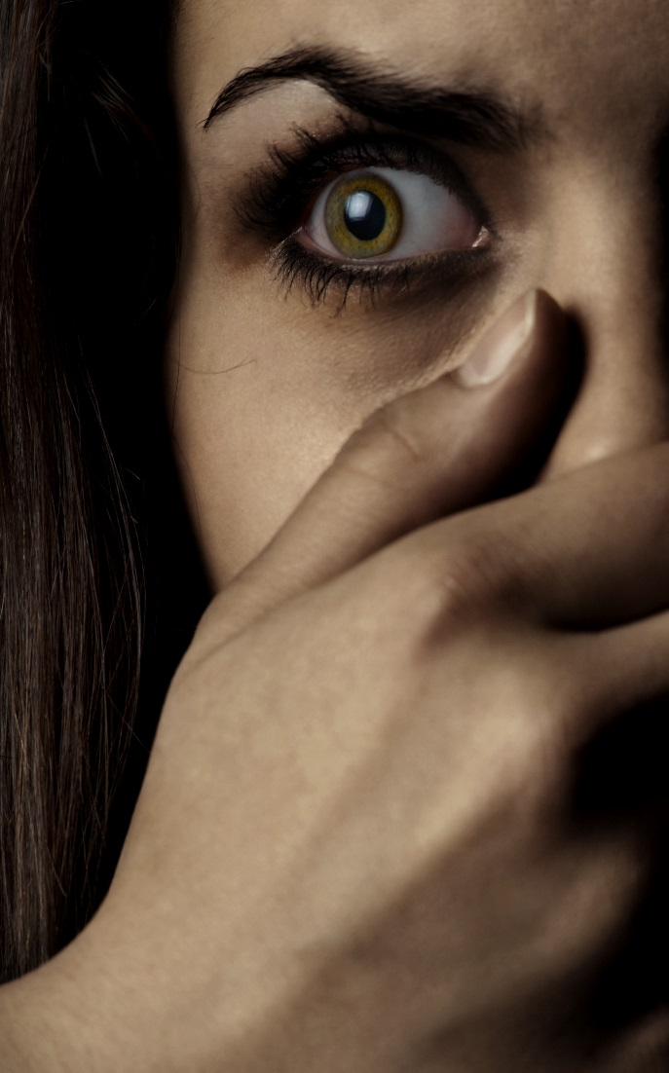
Human Trafficking
FORCE
Beating
Burning
Torture practices
Sexual Assault
Seasoning/Initiation
FRAUD
False Promises
Withholding wages
Blackmail, extortion
Deceitful behavior
Notes:
In Sex Trafficking, Pimps may also engage in a “Pimp Circle.” (The process of multiple pimps swarming and surrounding one woman or girl and hissing insults at her, for the purpose of humiliation and intimidation.

Slide 9
Human Trafficking
COERCION
Threats of serious harm
Intimidation/ humiliation
Emotional Abuse
Creating dependency
Quotas
ENTICEMENT
False promises of love/friendship
Guilt, Shame
Wanting to please
Promises of money/reward
Protection
Fear
Notes:
In Sex Trafficking, Pimps may also engage in a “Pimp Circle.” (The process of multiple pimps swarming and surrounding one woman or girl and hissing insults at her, for the purpose of humiliation and intimidation.

Slide 10
Human Trafficking
Things to know:
People are trafficked into many industries
Trafficking is visible; trafficking is accepted
Supply and demand fuel trafficking
“People smuggling” is not considered human trafficking
As many as one in five trafficking survivors fell prey a second time
Boys and men are trafficked too
Disability is attractive to traffickers
There is no one “profile” of a trafficker

Slide 11
Labor
Sex
Domestic Servitude
Agriculture
Begging
Tourism
Nail Salon
Factory Labor
Prostitution
Brothels
Clubs
Massage Parlors
Escort Services
Nanny
Live in Maid
Cook
Landscaper
Butler
Human Trafficking
Some Types of Trafficking

Slide 12
Human Trafficker
Traffickers do not have one profile
Potential Traffickers
Pimps
Intimate partners/family members
Gangs and Criminal networks
Brothel and fake massage business owners and managers
Growers and crew leaders in agriculture
Labor brokers
Employers of domestic servants
Small business owners and managers
Large factory owners and corporations

Slide 13
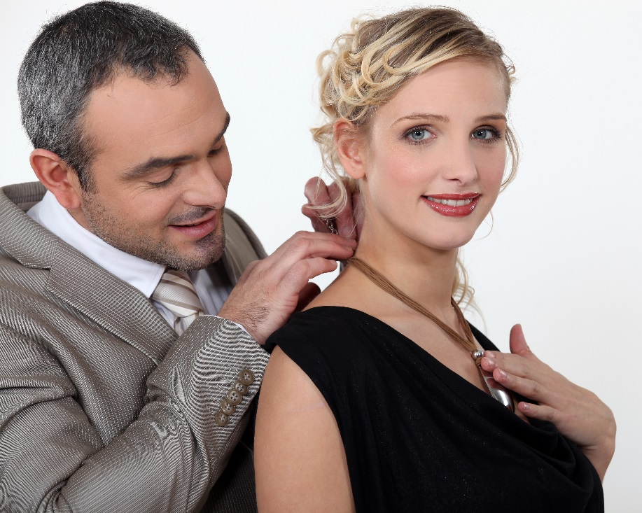
Becoming a Victim
Recruiting a Victim
Purposeful targeting
Warmth, gifts, compliments and sexual and physical intimacy
Selling of false love and “the Dream”
Elaborate promises of a better life, fast money and future luxuries

Slide 14
Becoming a Victim
“Grooming,” Breaking-down,” or “Seasoning”
Often Involves:
Beating/slapping/
whipping
Burning
Sexual Assault
Confinement
Other torture techniques
Emotional abuse
Re-naming
Creating a climate of fear
Removal from familiarity and support structure
Document Confiscation
Forced sexual education

Slide 15
Victims of Human Trafficking
Anyone can be a victim
Some populations are more vulnerable to victimization.
These may include: undocumented immigrants; runaway and homeless youth; victims of trauma and abuse; individuals with intellectual disabilities; refugees and individuals fleeing conflict; and oppressed, marginalized, impoverished groups and individuals, and/or individuals with low self-esteem.

Slide 16
Disabilities and Victimization
Persons with disabilities are almost twice as likely to be victims of violent crimes
Persons with cognitive disabilities are 30% more likely to be victims of violent crimes
68% of children with disabilities were victims of sexual violence
32% of children with disabilities were victims of physical violence
People with intellectual, cognitive or developmental disabilities are 7 times higher risk of becoming victims [6]
Notes:
In 2010, the age-adjusted violent victimization rate for persons with disabilities was almost twice the rate among persons without disabilities
28 per 1,000 individuals with disabilities vs 15 per 1,000 individuals without disabilities [2]
Persons with cognitive disabilities had the highest rate of violent victimization
30 per 1,000 individuals [3]
A five year retrospective study of children with disabilities in a pediatric hospital found that:
(a) 68% of the children with disabilities were victims of sexual violence and
(b) 32% were victims of physical violence [4]
In a retrospective study of hospital records over a ten year period with a population of 39,000, 6,000 children or 15% were victims of violence. Of the 6,000, 64% or 3,840 were children with disabilities.
Over half the sample or 54% were exposed to multiple forms of violence [5]

Slide 17
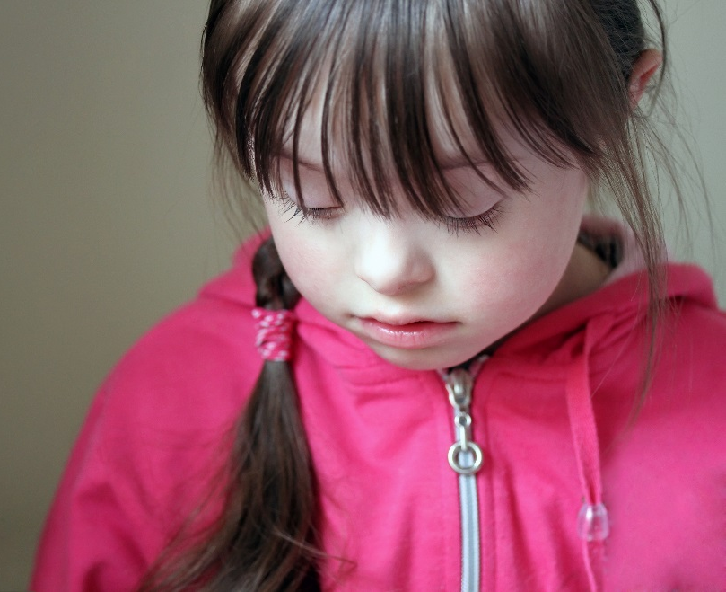
Disabilities and Victimization
In 2007 in China, around 1340 people were delivered from forced labor in brick kilns in a series of government-investigated rescues. Many were children and nearly one-third of them had intellectual disabilities.
17
Notes:
17

Slide 18
Increased Vulnerability
People with developmental disabilities are more likely to be victimized because of social stigma.
Unable to report the crime
Not considered credible reporters
Unable to differentiate between appropriate and inappropriate touching
May be socially isolated
Dependence on others for long-term care
Lack of economic independence
Lack of participation in abuse awareness and personal safety programs
Less education about sexuality and healthy intimate relationships
Communication challenges
Physical barriers to accessing supports and services
Victims of sexual, physical or mental abuse [1]
18
Notes:
18

Slide 19
Case files / FBI
U.S. v. Carlos Monsalve & U.S. v. Jorge Melchor
Part of Cartel
Close to 20 brothels operated by a Cartel around Florida
Melchor was Regional Pimp for NW Florida & Distributed business cards
Prostitution delivery service
Required at least four johns (15 min each) per call
25-40 sex transactions a night per victim
Notes:
Workers brought by two Philipino natives that owned two employment leasing companies.
Killearn similar to Ponavedra in Jax, Hide Park in Tampa, Celebration Orlando/Kissimmee, Pine Crest in Miami

Slide 20
Red Flags Of Human Trafficking
Common Work and Living Conditions:
Is under 18 and is providing commercial sex acts
Is in the commercial sex industry and has a pimp / manager
Is unpaid, paid very little, or paid only through tips
Works excessively long and/or unusual hours
Is not allowed breaks or suffers under unusual restrictions at work
Owes a large debt and is unable to pay it off
Was recruited through false promises concerning the nature and conditions of his/her work
High security measures exist in the work and/or living locations (e.g. opaque windows, boarded up windows, bars on windows, barbed wire, security cameras, etc.)

Slide 21
Red Flags Of Human Trafficking
Poor Mental Health or Abnormal Behavior:
Is fearful, anxious, depressed, submissive, tense, or nervous/paranoid
Exhibits unusually fearful or anxious behavior after bringing up law enforcement
Avoids eye contact
Poor Physical Health:
Lacks health care
Appears malnourished
Shows signs of physical and/or sexual abuse, physical restraint, confinement, or torture

Slide 22
Red Flags Of Human Trafficking
Lack of Control:
Has few or no personal possessions
Is not in control of his/her own money, no financial
records, or bank account
Is not in control of his/her own identification documents (ID
or passport)
Is not allowed or able to speak for themselves (a third party
may insist on being present and/or translating)

Slide 23
Red Flags Of Human Trafficking
Other:
Claims of just visiting and inability to clarify where he/she is
staying/address
Lack of knowledge of whereabouts and/or do not know
what city he/she is in
Loss of sense of time
Has numerous inconsistencies in his/her story
New commodities (Cell phone, clothes, etc.)
Sudden Manicured nails, hair and jewelry

Slide 24
Behavioral Signs of Abuse
CHANGES in the way affection is shown, especially if unusual or inappropriate
Suddenly fears being touched
Sudden onset of nightmares
CHANGES in sleep patterns; difficulty sleeping
Sudden regression to childlike behaviors (i.e., bed-wetting, thumb-sucking)
Sudden unusual interest in or knowledge of sexual matters (including excessive masturbation)
Cruelty to animals
Sudden fear of bathing or toileting
Sudden fear of a person or place
Depression, withdrawal, or mood swings
ANY UNEXPLAINED CHANGE IN BEHAVIOR

Slide 25
Signs of Sexual Abuse
Frequent urinary tract infections or yeast infections
Painful urination
Abrasions, bleeding, or bruising in the genital area
Incontinence in someone who was previously toilet-trained
Frequent sore throats
Sudden onset of psychosomatic complaints (males most frequently complain of stomach aches while females most frequently report headaches)
Sudden difficulty walking or sitting
Vaginal or rectal pain

Slide 26
Signs of Exploitation
Sudden decrease in bank account balances
Sudden change in banking practices (such as making several large withdrawals from a bank account or ATM over a period of several days instead of one small withdrawal each week)
Sudden problems paying bills or buying food or other necessities
Sudden changes in wills or other financial documents

Slide 27
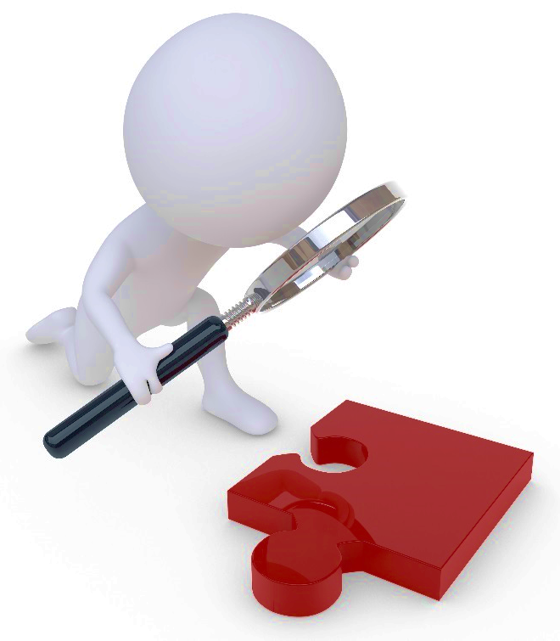
Hard to Recognize
Victim does not recognize abuse, neglect, or exploitation
Communication challenges
Some symptoms may be interpreted as behavioral problems or traits of their disability
Victims may be coerced and not appear to be a victim
Fear and training prevent disclosing
Notes:
Miami Victim

Slide 28
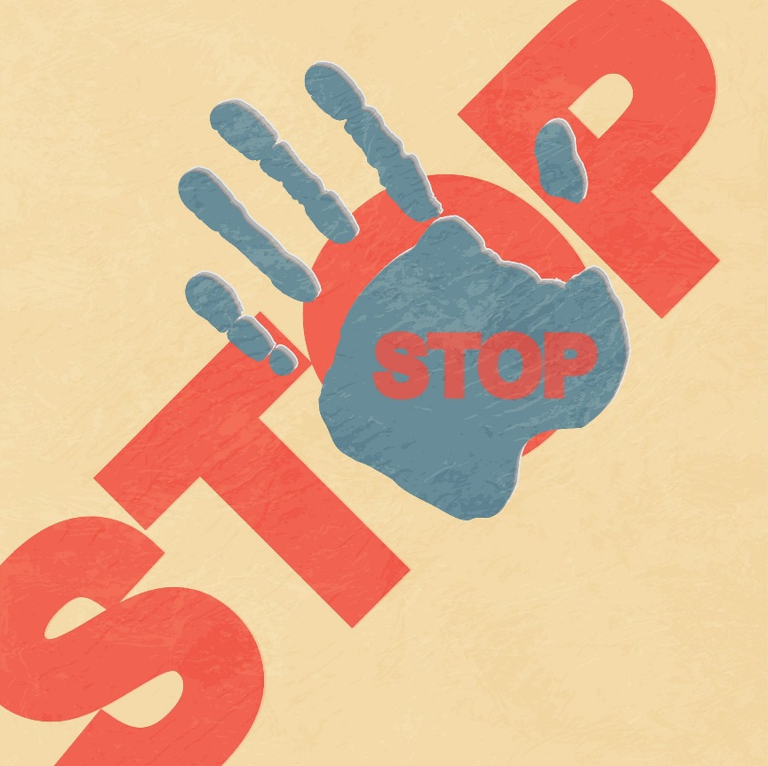
Protection and Prevention from Human Trafficking:
Enhance participation within the community
Ensure children with disabilities are at school or in other ways visible to their communities
Recognize and address stigma and discrimination that exists

Slide 29
Protection from Disability Trafficking:
Learn the “red flags”
Report suspected human trafficking
Get involved with your local task forces
Meet with or write your local, state, and federal government representatives

Slide 30
Responding to a victim
Separate victims from trafficker
I believe you.
It is not your fault.
You are not alone.
I want to help you.
You are safe now.
You have rights.
You can trust me.
You are a victim.
You are not in trouble
We can help you.
More information at: (http://www.acf.hhs.gov/sites/default/files/orr/communictating_with_victims_of_human_trafficking.pdf)
Notes:
Establish Rapport. Be sincere!
Leave the investigation to Law Enforcement.

Slide 31
Reporting Suspected Human Trafficking
Call DCF Abuse Hotline
1-800-962-2873
Call National Human Trafficking Hotline
1-888-373-7888
Department of Homeland Security
1-866-347-2423 or at www.ice.gov/tips
Contact local law enforcement
Notes:
Can request to be anonymous

Slide 32
Mandated Reporters
Everyone in Florida has a responsibility to report known or suspected abuse, neglect, or exploitation
Failure to report known or suspected cases of abuse, neglect, or exploitation is a 3rd degree felony.
Changed with the passage of HB1355/ SB 1816 (impacting Chapter 39.205(1) Florida Statute)
Notes:
Previously a first degree misdemeanor

Slide 33
Mandated Reporters
Professionally Mandated Reporters
Physician, osteopathic physician, medical examiner, chiropractic physician, nurse, or hospital personnel engaged in the admission, examination, care, or treatment of persons;
Health or mental health professional ;
Practitioner who relies solely on spiritual means for healing;
School teacher or other school official or personnel;
Social Worker, day care center worker, or other professional child care, foster care, residential or institutional worker;
Law enforcement;
Judge.
Chapter 39.201(1)(d) Florida Statute

Slide 34
Resources
Fitzsimmons, N.(2009). Combating Violence & Abuse of People with Disabilities: A Call to Action. Baltimore: Paul H. Brookes Publishing Co.
Harrell, E. (2012). Crime Against Persons with Disabilities, 2008-2010 - Statistical Tables, (Washington, DC: Bureau of Justice Statistics, U.S. Department of Justice, 2011), 3, http://bjs.ojp.usdoj.gov/content/pub/pdf/capd10st.pdf.
Ibid., 4.
Willging, J.P., Bower, C.M. and Cotton, R.T. (1992). Physical abuse of children: A retrospective review and otolaryngology perspective. Archives of Otolaryngology and Head and Neck Surgery, 118, (6), 584-590.
Sullivan, P.M. and Knutson, J.F. (1998). The association between maltreatment and disabilities in a hospital-based epidemiological study. Child Abuse and Neglect, 22, (4), 271-288.
Sobsey, D. (1994). Violence and abuse in the lives of people with disabilities. Baltimore: Paul H. Brookes Publishing Co.

Slide 35
Questions?

